Slide 1
Robocup Gameplay Training:
Python and State Machines
Session 3

Slide 2

Python!
Update on Training
How’s it going?
Who is attending?
Any comments?
Python Tutorial
White Space is a thing
We can’t teach a full year of programming in one hour, however...
https://youtu.be/N4mEzFDjqtA
Questions?
Additional resources
Python Beginner Hub
Python Syntax Overview
A intro to python

Slide 3

Skills
Involves only one robot
Basic building block
Examples:
Move
Kick
Face a direction
Capture a ball
Located in soccer/gameplay/skills

Slide 4
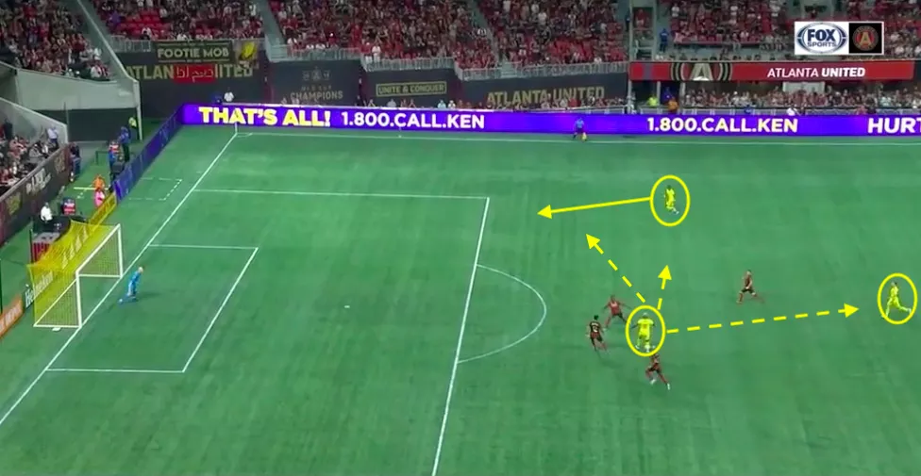
Tactics
Usually involves multiple robots
Utilizes skills
Can contain unique behavior
Examples:
Pass
Defend
Line Up
Located in soccer/gameplay/tactics

Slide 5
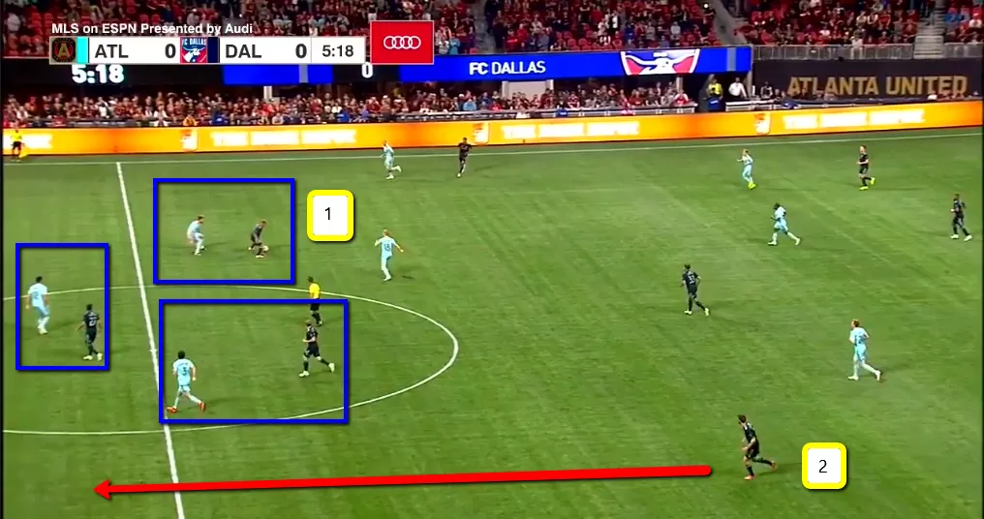
Plays
Only one can run at a time
Utilize tactics and skills
Examples
Basic 122 (basic offense)
Adaptive Formation (basic offense)
Stopped Play
Repeated Line Up
Corner Kick
Located in soccer/gameplay/plays
Only plays are actually runable
If you want to run a skill/tactic you need to make a dummy play that runs them.

Slide 6
Simple Behavior Task
Nice Features
constants.Field.Length
constants.Field.Width
skills.Capture.capture
skills.*
Goals
Understand how to use skills
Understand which points correspond to different locations on the field
File
Use SimpleBehaviors.py in gameplay/plays/training folder
In Sim, check off the SimpleBehavior play and run
Replace skills.Move.move with different skills or change the position point
Assignment
Make a robot move to the following locations
Four corners of the field
Center of the field
Make a robot capture a ball
Make a robot capture a ball
Make a robot shoot using a line kick
Make a robot shoot using a pivot kick
Tactic Extension
Make robots do a coordinate pass
Make a robot become a submissive defender (use tactics.submissivedefender)
Make a robot become goalie

Slide 7
State Machines
What is a State Machine?
A state machine is a series of states
You can transition between them
A state can transition to multiple other states
A state transition only occurs if a condition is fulfilled
Examples
A washing machine is a state machine, going between different states to cycle between wash, dry, etc based on time.
School are state machines, where you transition to different classes at certain times.
Wikipedia Page on State Machines

Slide 8
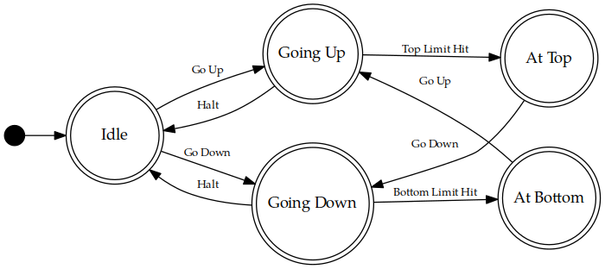
Elevator Example

Slide 9
Robocup State Machines
Skills, tactics, and plays all have internal states
We define those states using enums (enum.Enum)
Behaviors has some default states that we use called start, running, complete
Each state has an on_enter, execute, and on_exit
on_enter and on_exit are run once at the beginning and end of the state.
Execute is run repeatedly while we are in a state after on_enter and before on_exit
How do we implement state machines into our code?
Defining States
Defining Transitions
Defining State Actions
(on_enter, execute, on_exit)
Let’s look at WhichHalf

Slide 10
Additional State Machine Resources
A quick block about state machines
You might be using state machines in a hacky way already…
Our Current State Machine Implementation

Slide 11
Subbehaviors
A Subbehavior is a skill, tactic, or play that we call inside our program
For more docs on this entire section see this
These subbehaviors show up in the behavior tree when you run your program.
This can be extremely useful when debugging state transitions or subbehavior assignments.

Slide 12
Adding Subbehaviors
self.add_subbehavior(skill_object, "Name of Subbehavior", required=False or True, priority=10)
Skill_object-
What play/tactic/skill we are adding
Name
A string to describe the subbehavior
Required
A boolean to tell role-assignment that this behavior must be done
Not necessary for complex-behaviors and single robot complex behaviors
Priority
A higher number is higher priority
Not required for complex behaviors and single robot complex behaviors

Slide 13
Removing and Getting Subbehaviors
Removing Subbehaviors
self.remove_subbehavior(‘string name’)
self.remove_all_subbehaviors()
Getting Subbehavior Plays
A_subbehavior = self.subbehavior_with_name(‘string name’)

Slide 14
Triangle Pass
Nice Features
constants.Field.Length
constants.Field.Width
skills.capture.Capture
skills.move.Move
tactics.coordinated_pass.CoordinatedPass
robocup.Point
Goals:
Make three robots pass in a triangle using state machines
File:
Use training_triangle_pass.py in plays/training
Assignment
Repeated pass the ball to three predefined points
Examples: (0, Length/2), (length/3, length/3), (-length/3, length/3)
State ideas:
Capture
Pass

